Slide 1
Looking at Visual Attention in Value-Based Decision Making
Brenden Eum
Rotman Brownbag Presentation

Slide 2
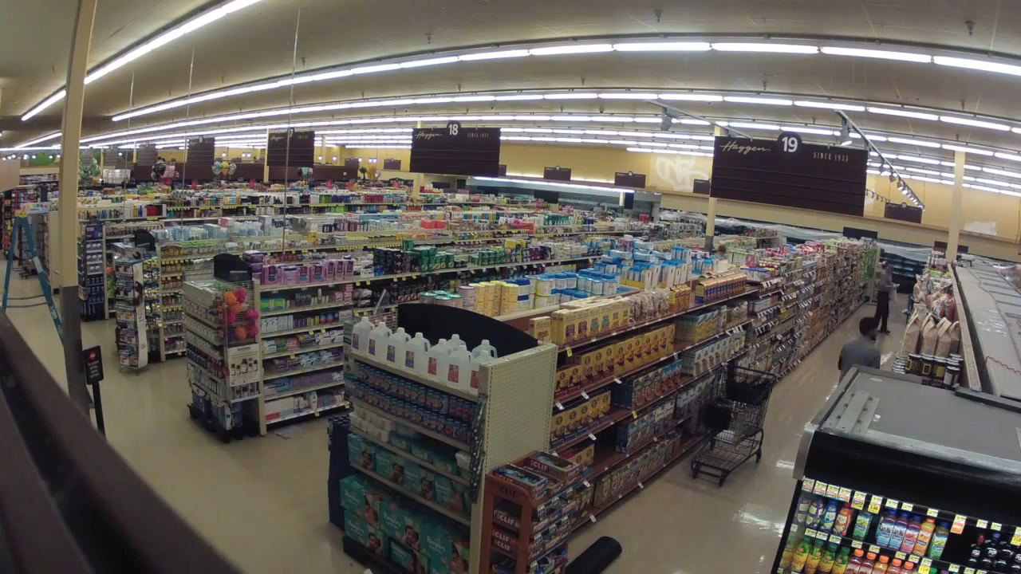




Slide 3
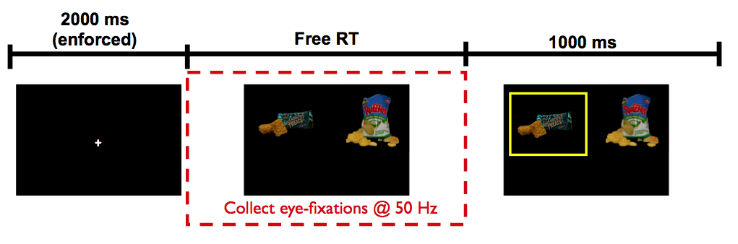
Krajbich, Armel, Rangel (2010, Nat Neuro)

Slide 4
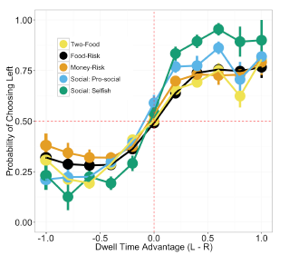
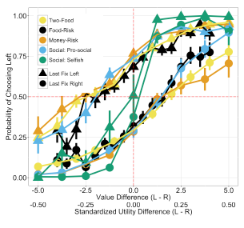
Net Fixation Bias
Last Fixation Bias
Smith, Krajbich (2018, J Exp Psychol Gen)
Notes:
multiple domains

Slide 5
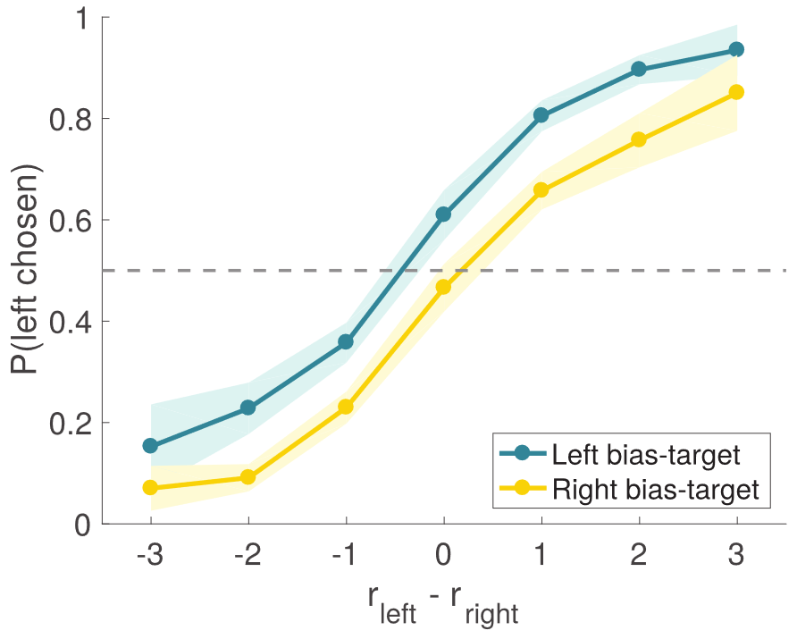
Tavares, Perona, and Rangel (2017, Front Neurosci)
Notes:
multiple domains

Slide 6
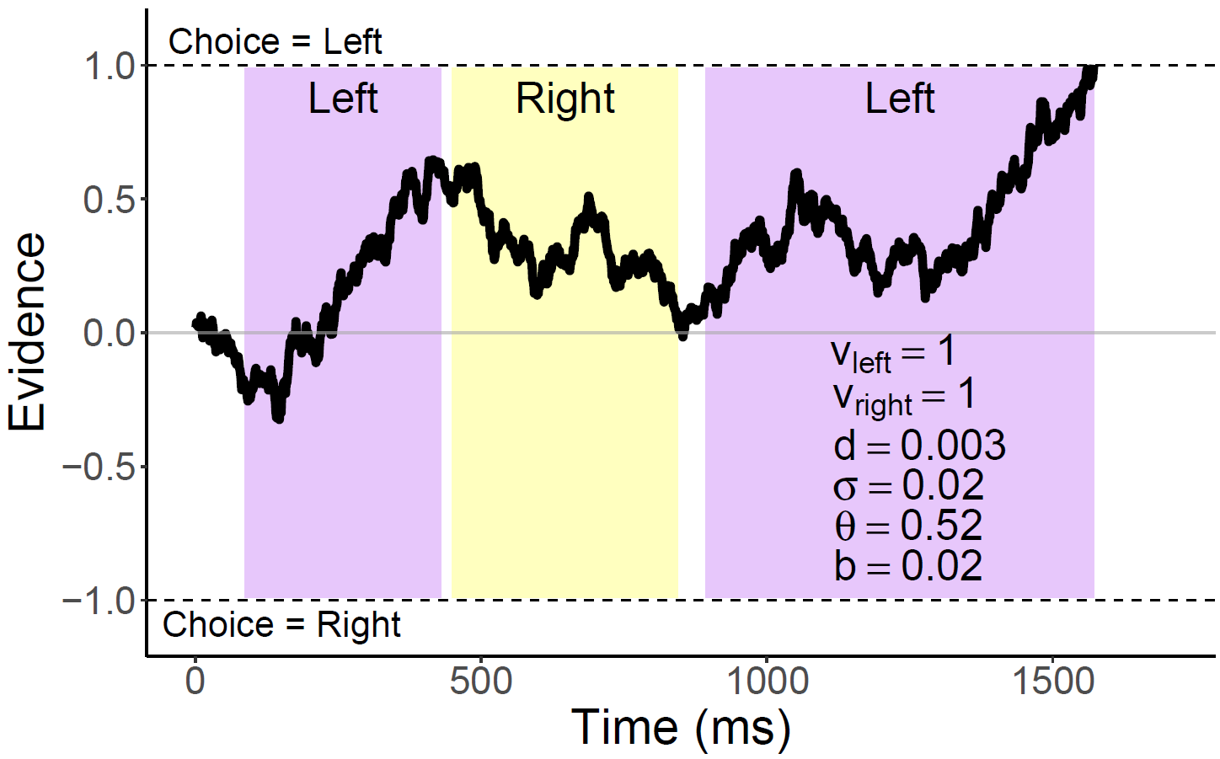
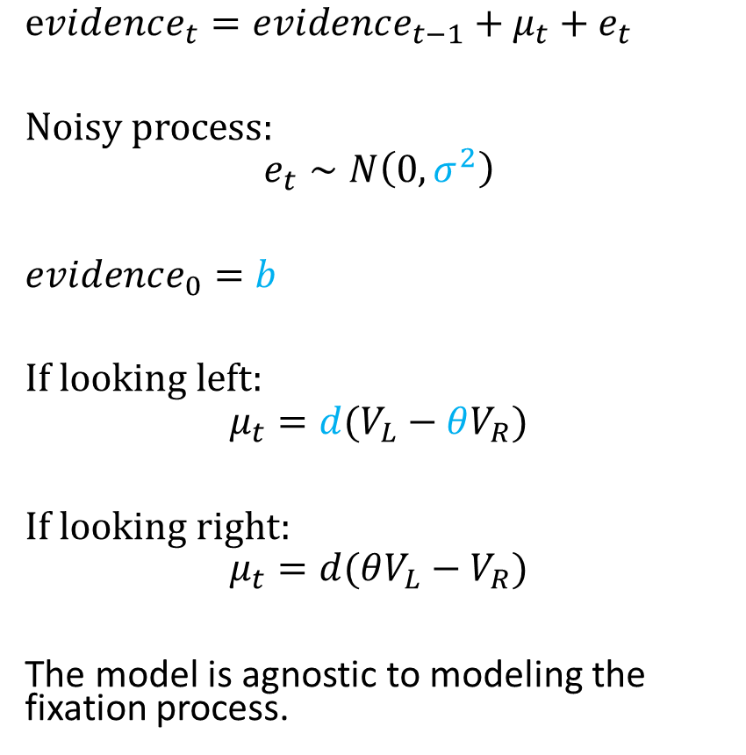
Attentional Drift-Diffusion-Model (aDDM)
$evidence_{t}=evidence_{t−1}+μ_{t}+e_{t}$
Noisy process:
$$e_{t}∼N\left(0, σ^{2}\right)$$
$evidence_{0}=b$
If looking left:
$$μ_{t}=d(V_{L}−θV_{R})$$
If looking right:
$$μ_{t}=d(θV_{L}−V_{R})$$
The model is agnostic to modeling the fixation process.
Notes:
noisy
bias
drift: ddm in value based decisions: evidence accumulated is value comparison
drift
sim
explain fixation sampling process

Slide 7
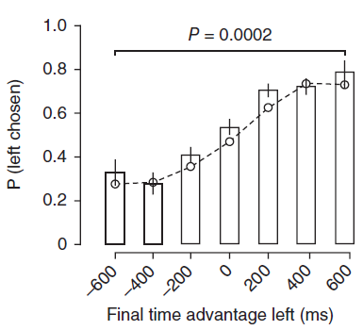
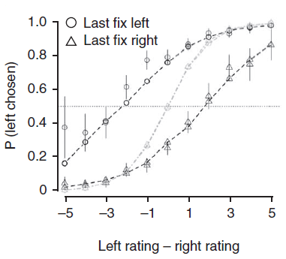
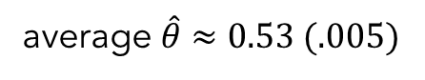
aDDM Predictions
average $\hat{θ}≈0.53 (.005)$
1. Attentional Discounting
2. Net Fixation Bias
3. Last Fixation Bias
Bhatnagar, Orquin (2022, J Exp Psychol Gen)
Krajbich, Armel, Rangel (2010, Nat Neuro)

Slide 8
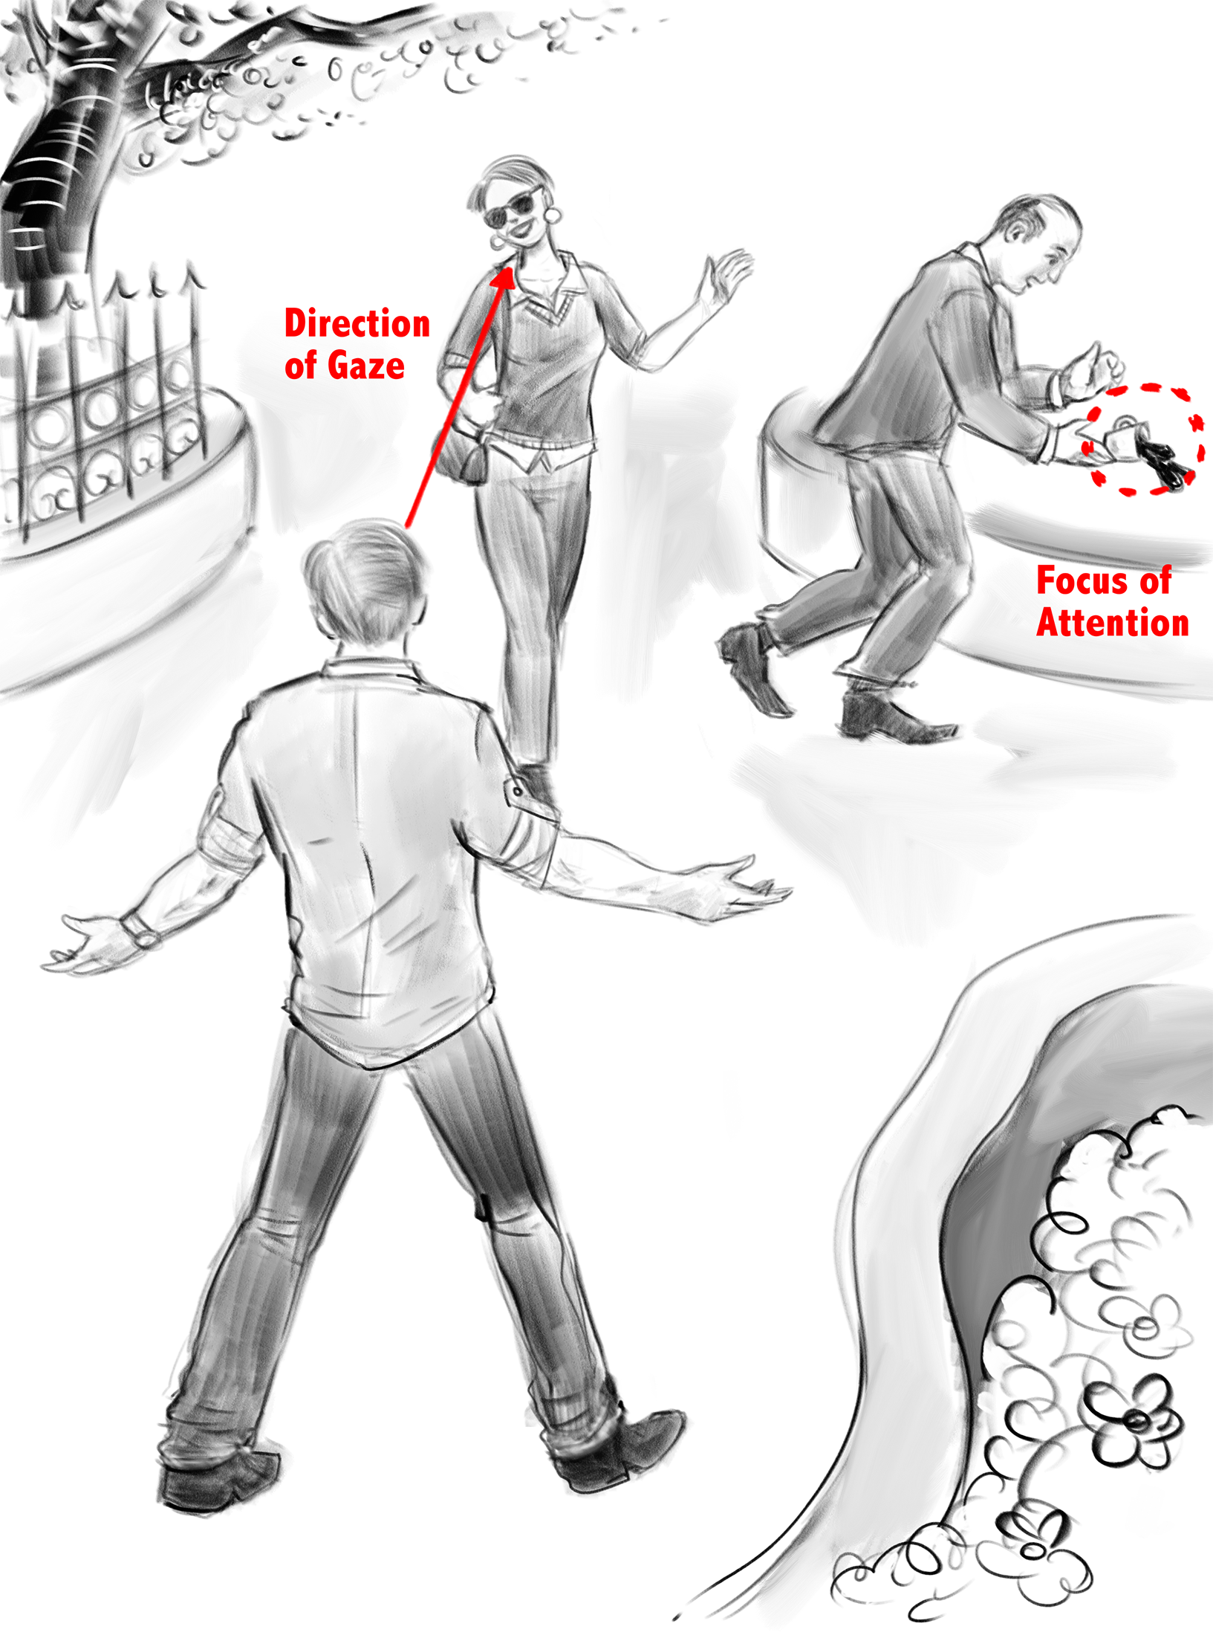
Overt vs Covert Attention
Drawing by Dr. Peter Coppin, OCAD
Notes:
overt
covert
bulk of literature overt

Slide 9



Slide 11
Does peripheral visual information play a role in the decision-making process?

Slide 12


Slide 13
Peripheral Visual Information Halves Attentional Choice Biases
Brenden Eum
Stephanie Dolbier
Antonio Rangel
[forthcoming, Psychological Science]

Slide 14
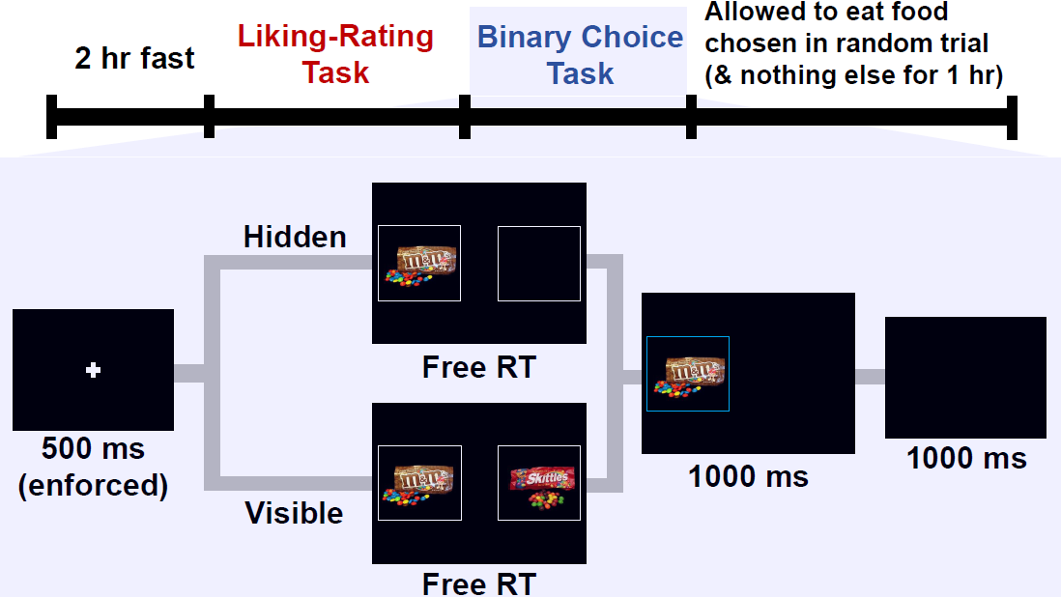
Notes:
liking ratings provide an independent measure of value

Slide 15
Questions
Does removing peripheral visual information affect our choices?
If so, how is it affecting our choices?
Does it change our fixation process?
Does it change our value comparison process?

Slide 16
Inference Strategy
Joint Dataset
Exploratory Sample
N = 25
360 trials
Confirmatory Sample
N = 25
400 trials

Slide 17
Does removing peripheral visual information affect our choices?

Slide 18
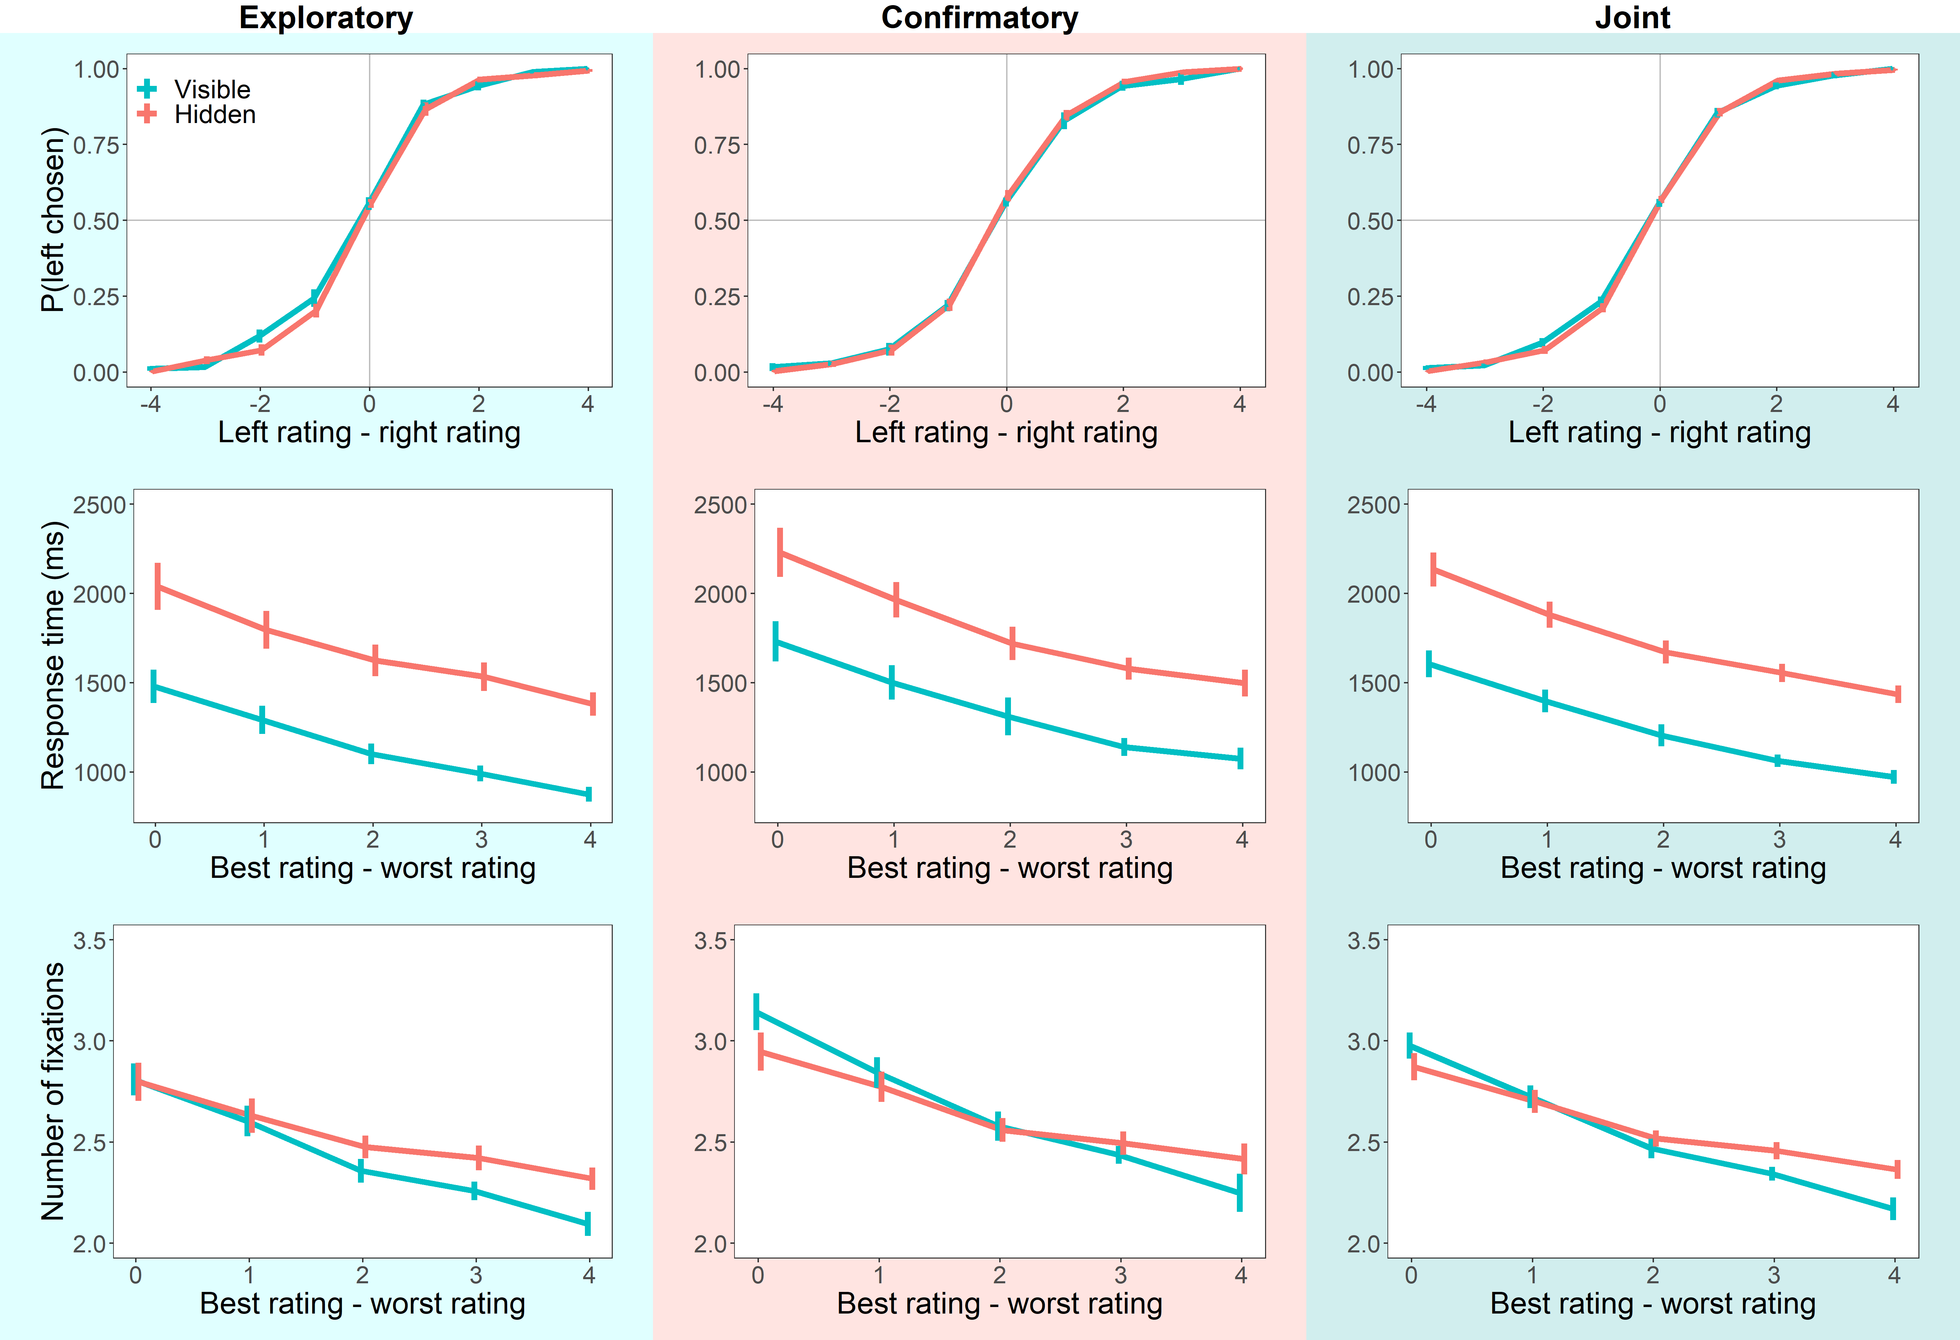
Average Choices and Response Times

Slide 19
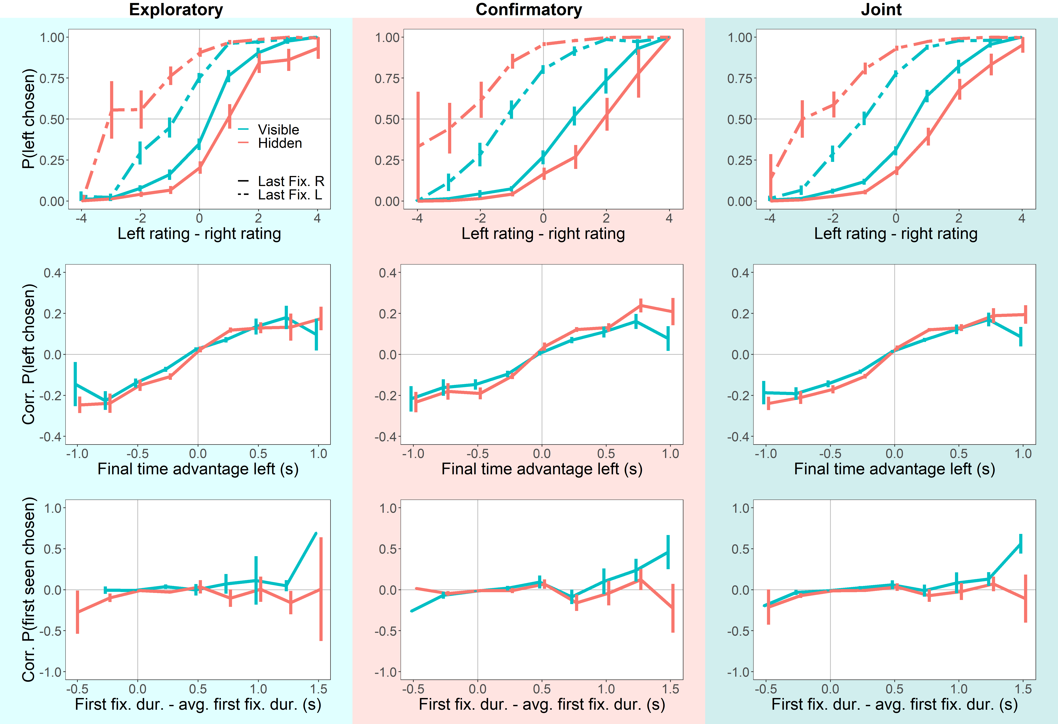
Attentional Choice Biases
Last Fix. Bias

Slide 20
Attentional Choice Biases
Net Fix. Bias

Slide 21
Questions
Does removing peripheral visual information affect our choices?
If so, how is it affecting our choices?
Does it change our fixation process?
Does it change our value comparison process?
Yes

Slide 22
Does removing peripheral visual information affect our fixation process?

Slide 23
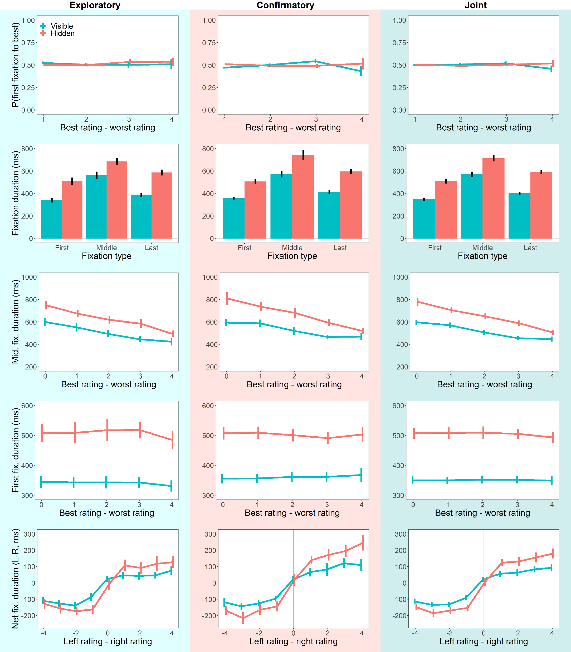
Fixation Process

Slide 24
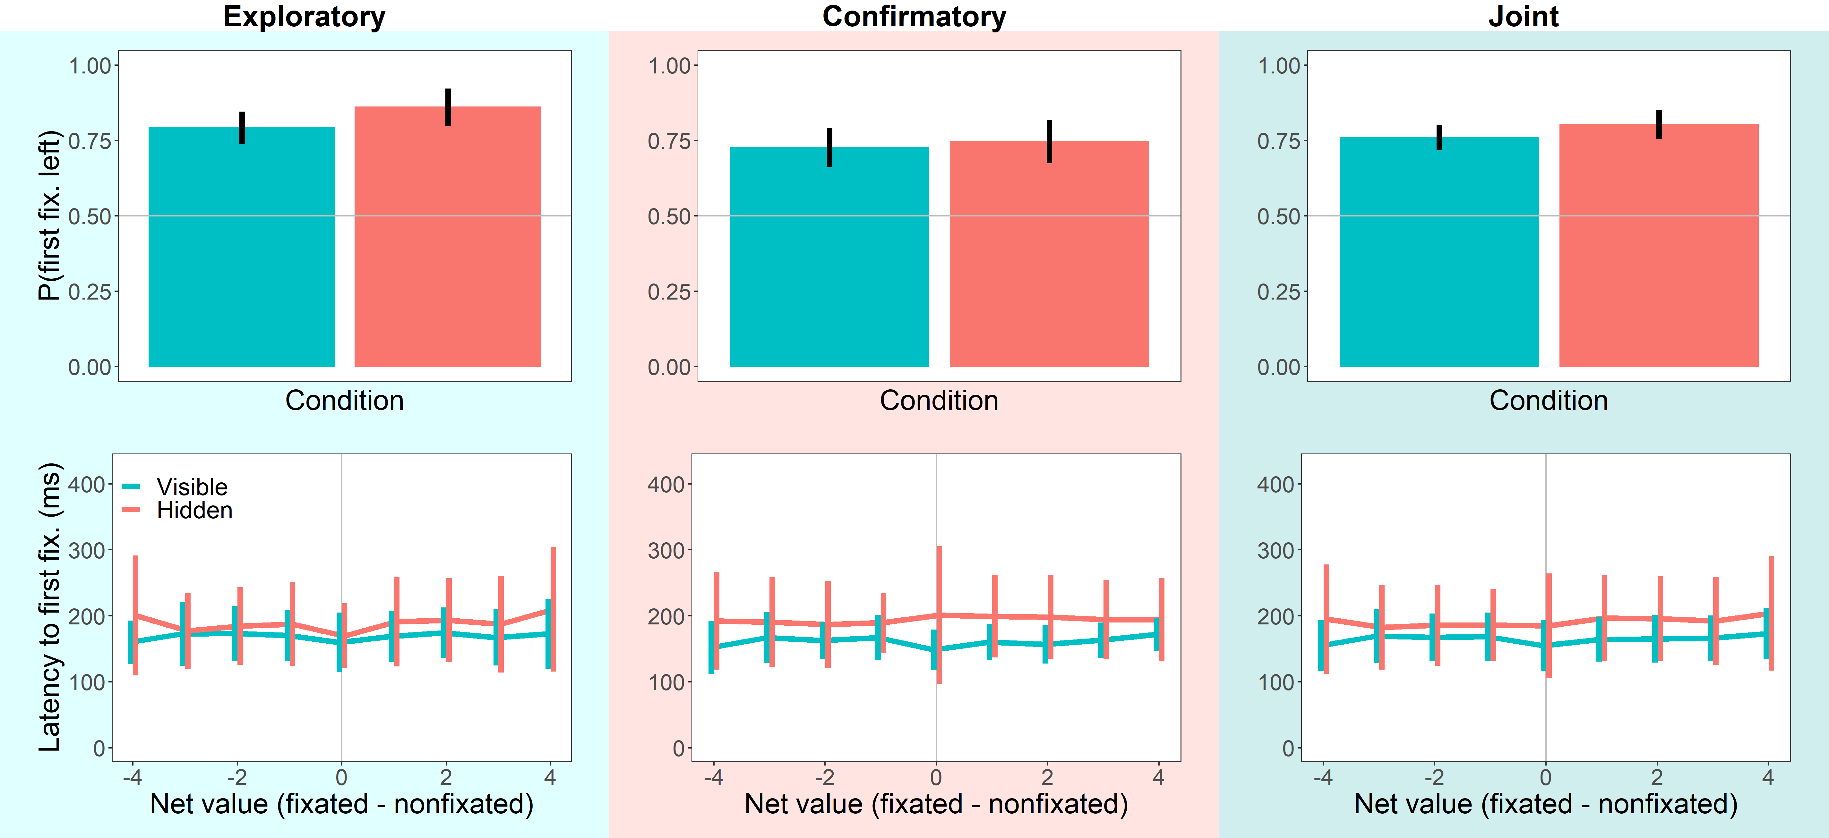
First Fixations

Slide 25
Net Fixation

Slide 26
Questions
Does removing peripheral visual information affect our choices?
If so, how is it affecting our choices?
Does it change our fixation process?
Does it change our value comparison process?
Yes

Slide 27
Does removing peripheral visual information affect the value comparison process?

Slide 28
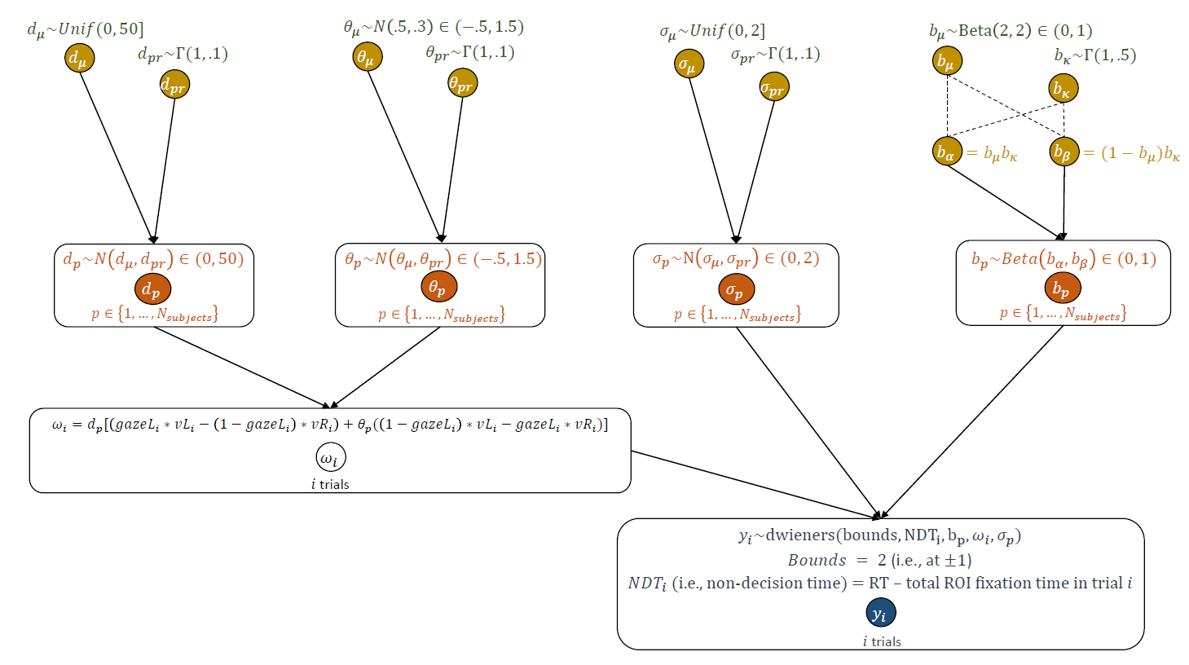
Hierarchical Bayesian aDDM
Group-Level
Individual-Level
Lombardi & Hare Toolbox (2021)
Notes:
estimates the parameters of the aDDM in a fraction of the time compared to previous toolboxes
gives full posteriors, which allows for hypothesis testing

Slide 29
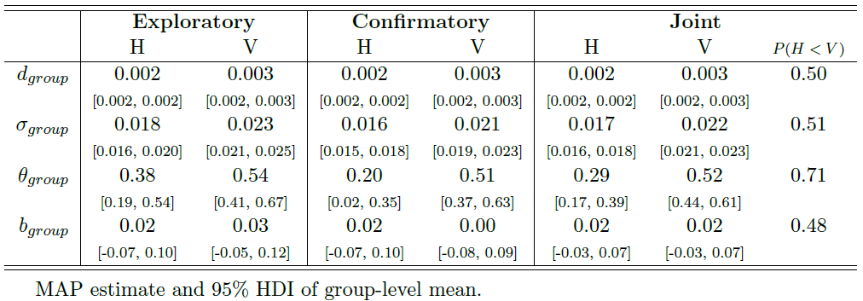
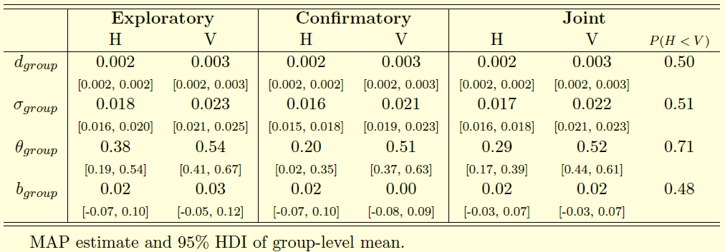
MAP Estimates of Group-Level Mean
speed of accumulation
noise
attentional discounting
biased starting point
Notes:
what do the parameters mean?
drift and noise smaller.
beta same.
key point: theta.

Slide 30
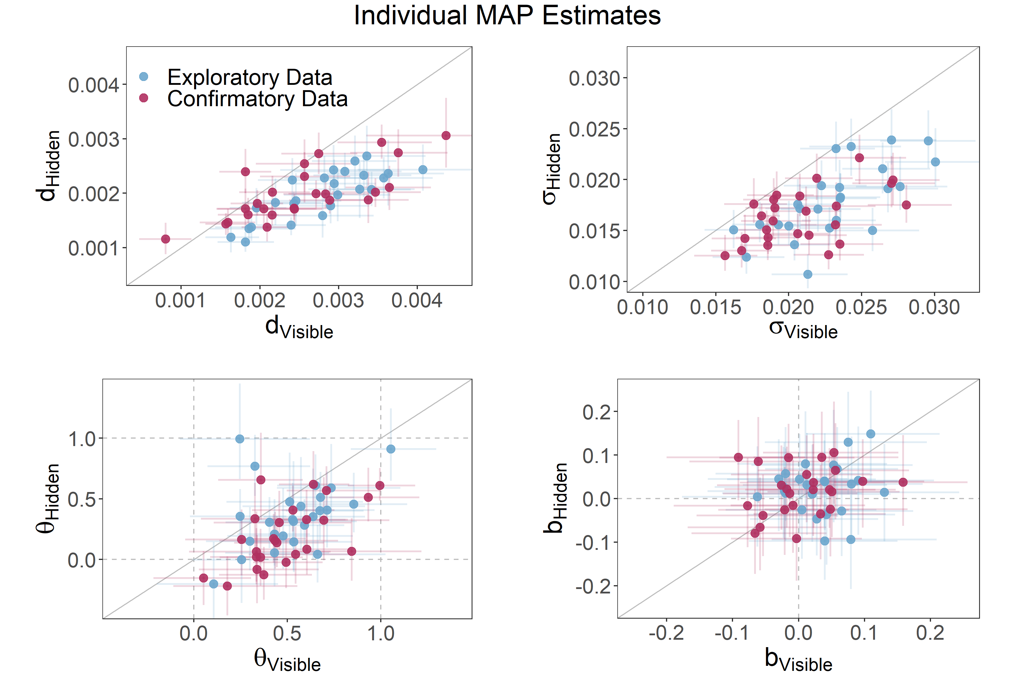
Individual-Level MAP Estimates
Notes:
individual level estimates mirror the group level estimates
\theta > 0 N=43
\theta <= 0 N=7

Slide 31
Questions
Does removing peripheral visual information affect our choices?
If so, how is it affecting our choices?
Does it change our fixation process?
Does it change our value comparison process?
Yes

Slide 32
Questions
Does removing peripheral visual information affect our choices?
If so, how is it affecting our choices?
Does it change our fixation process?
Does it change our value comparison process?

Slide 33

Questions
Does removing peripheral visual information affect our choices?
If so, how is it affecting our choices?
Does it change our fixation process?
Does it change our value comparison process?
What is the relative importance of the different mechanisms?

Slide 34
Out-of-Sample Simulations

Slide 35
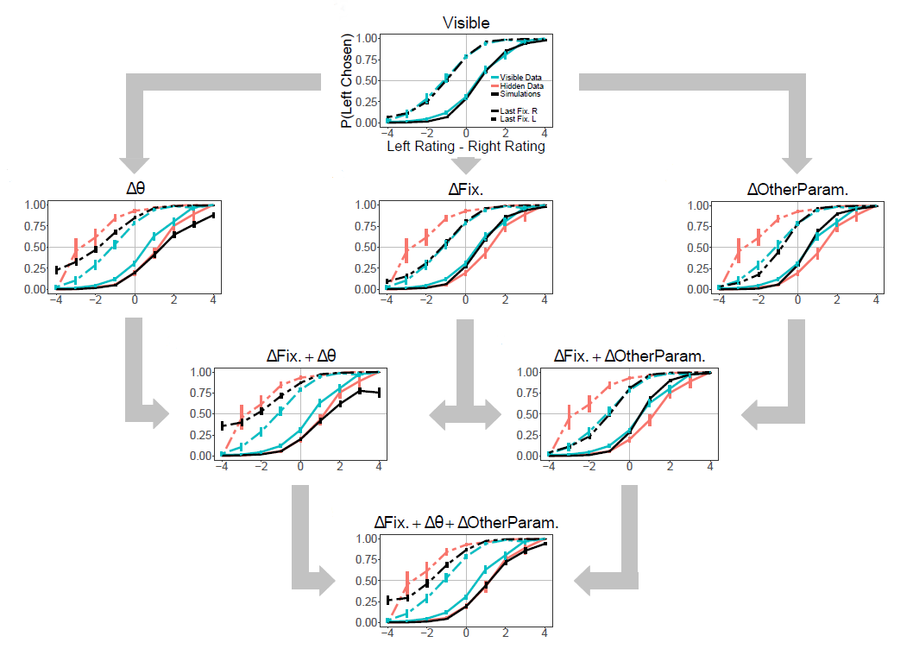

Slide 36
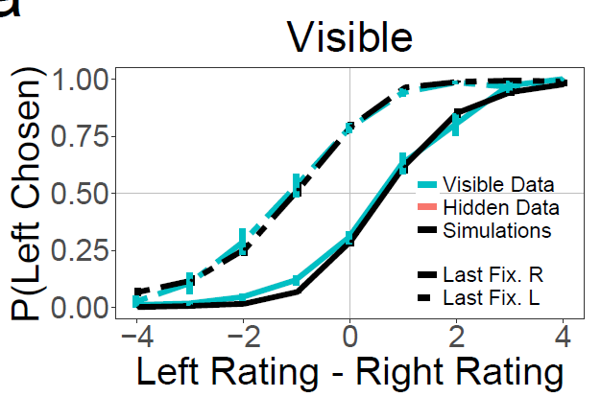

Slide 37
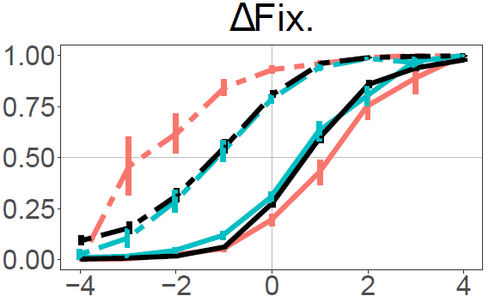

Slide 38
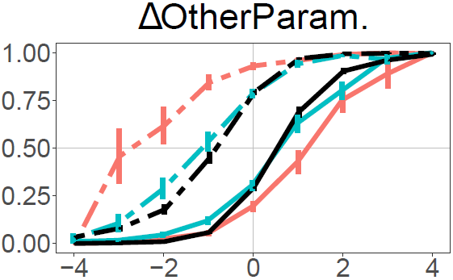

Slide 39
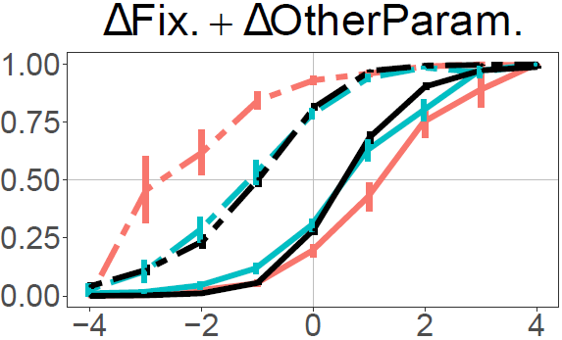

Slide 40
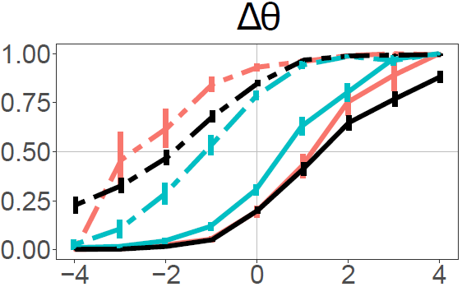

Slide 41
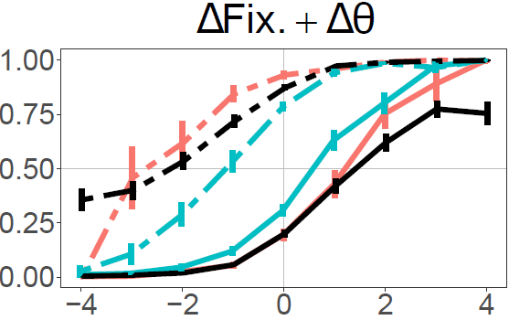

Slide 42
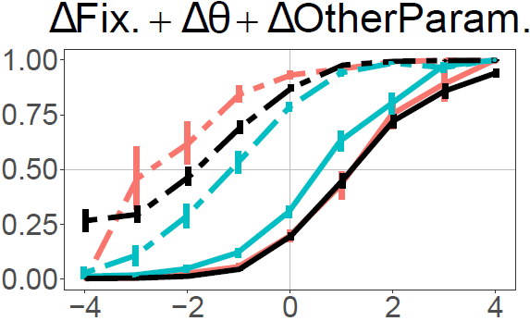

Slide 43
Questions
Does removing peripheral visual information affect our choices?
If so, how is it affecting our choices?
Does it change our fixation process?
Does it change our value comparison process?

Slide 44
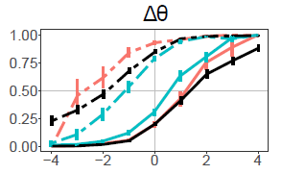
Summary
Removing peripheral visual information…
has minimal impact on average quality of choices, but doubles the magnitude of attentional choice biases.
slows down fixations by about 30%.
primarily affects attentional choice biases via an attentional discounting mechanism during value comparison.

Slide 47



Slide 48
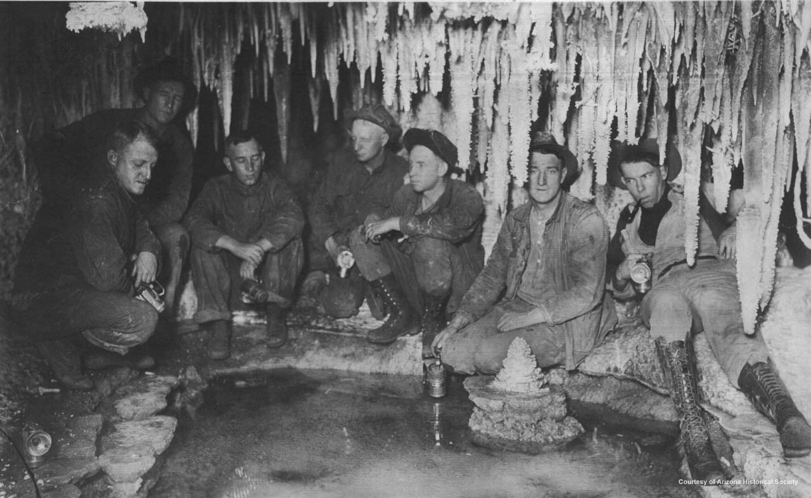
Copper Miners in Bisbee, Arizona
Notes:
Copper Miners in Bisbee, Arizona

Slide 49
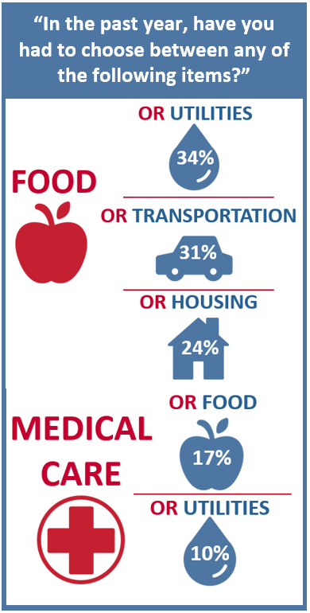
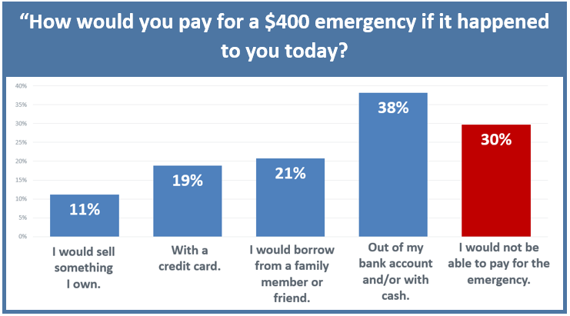
The Center for Community Solutions, Cleveland, Ohio

Slide 51
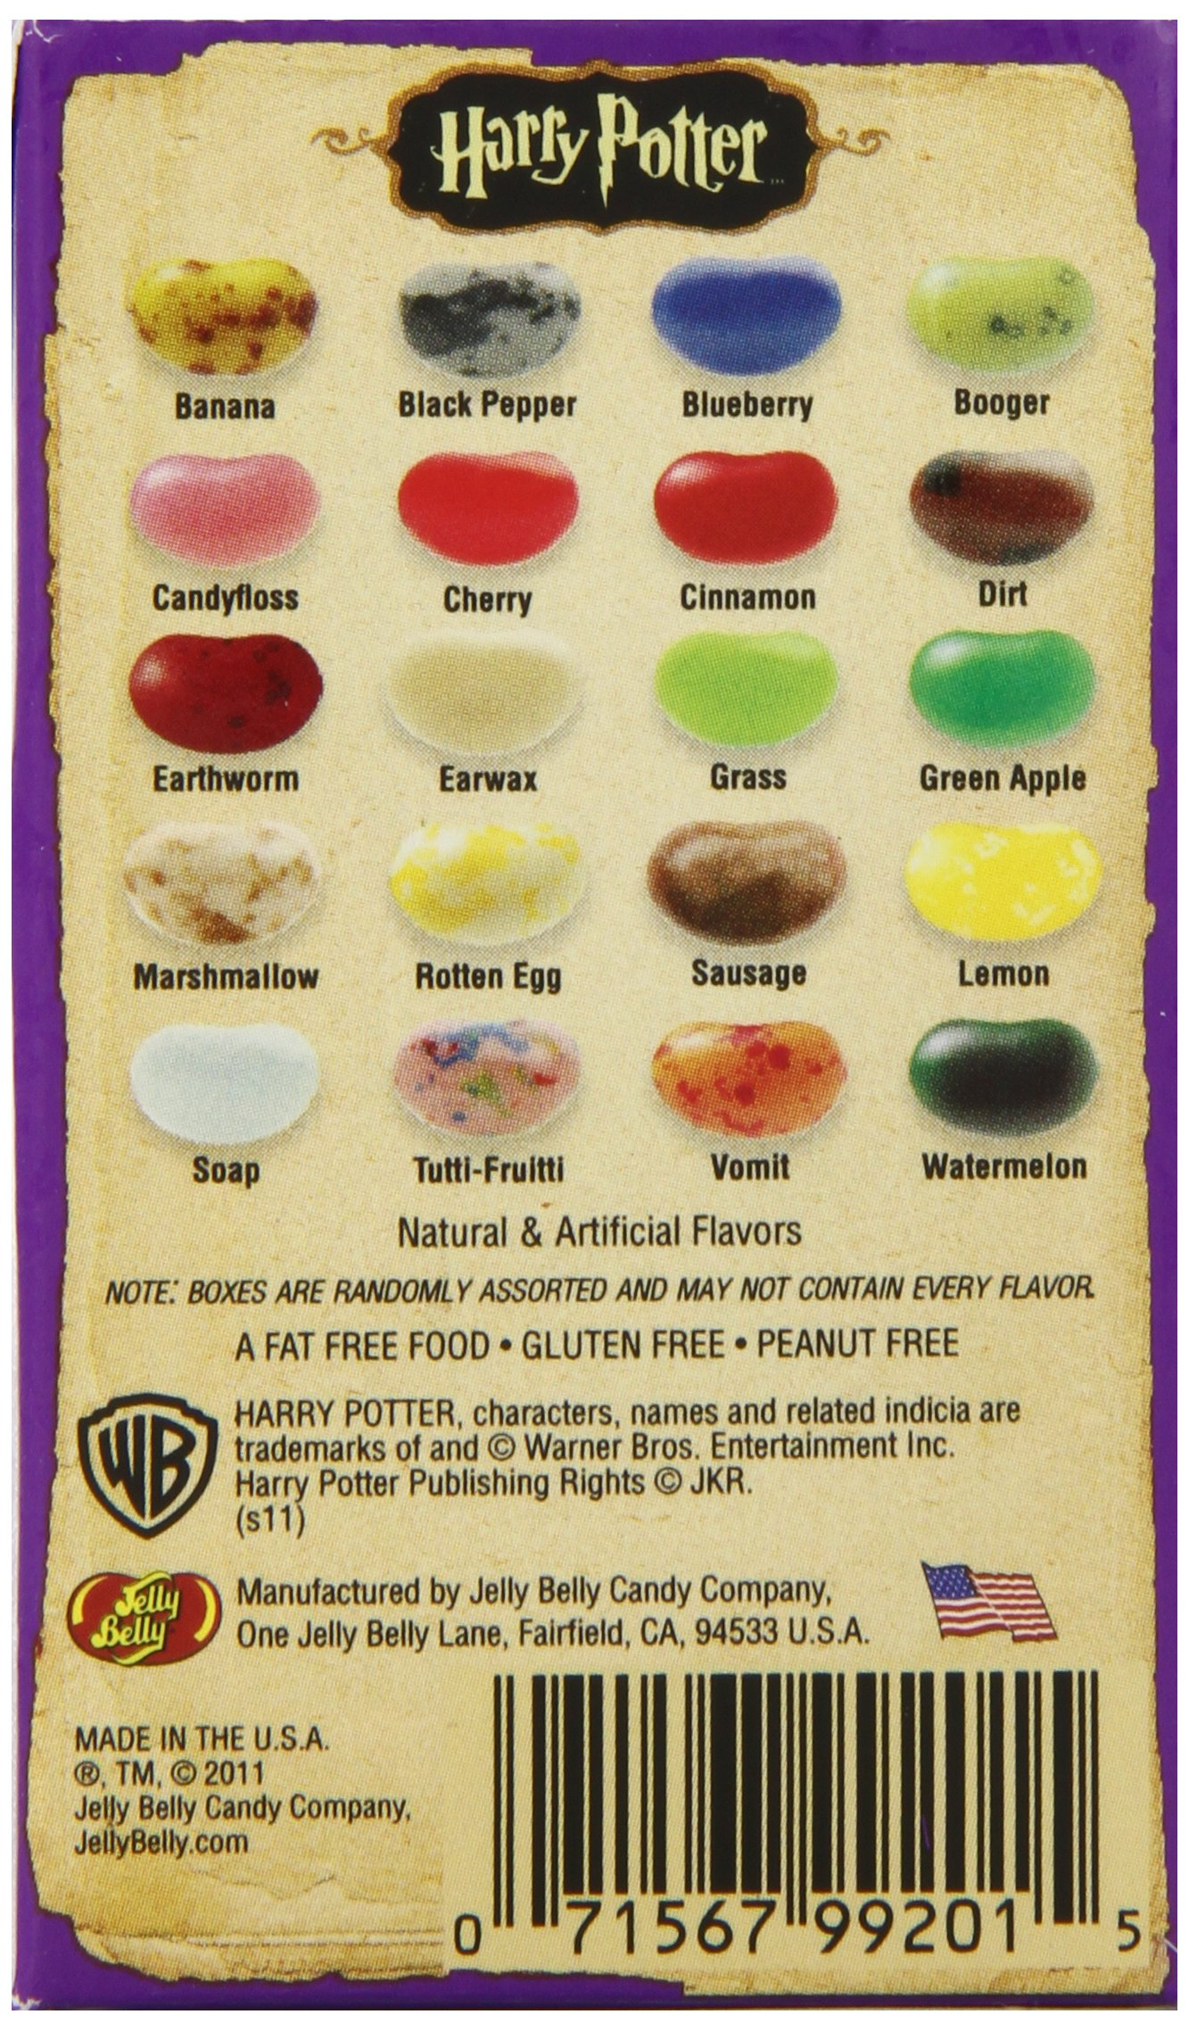

Slide 52
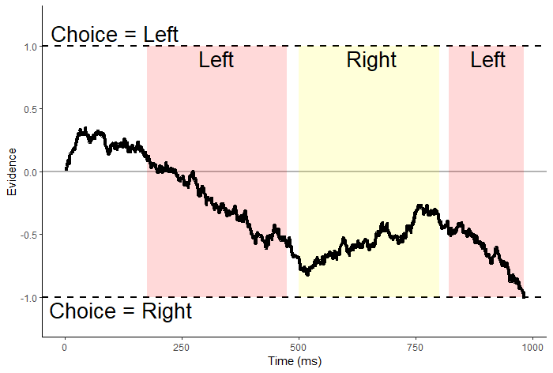
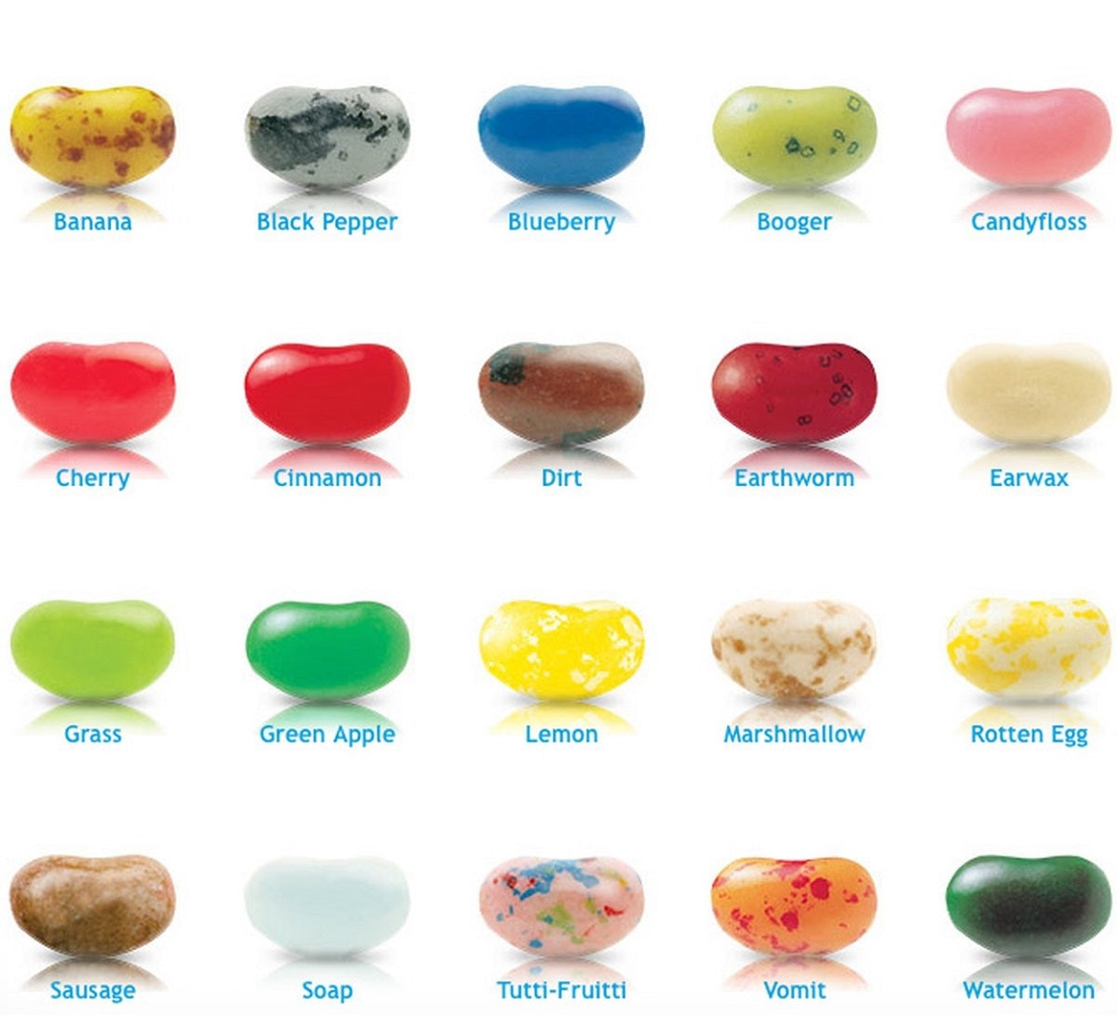
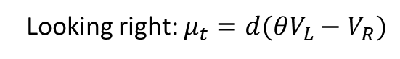
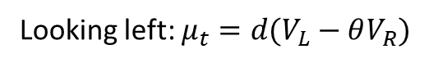
$evidence_{t}=evidence_{t−1}+μ_{t}+e_{t}$
Looking left: $μ_{t}=d(V_{L}−θV_{R})$
Looking right: $μ_{t}=d(θV_{L}−V_{R})$

Slide 53
$evidence_{t}=evidence_{t−1}+μ_{t}+e_{t}$
Looking left: $μ_{t}=d(V_{L}−θV_{R})$
Looking right: $μ_{t}=d(θV_{L}−V_{R})$
If attentional discounting persists in choices between losses,
then the value of the nonfixated option should seem less negative.

Slide 54
Attentional choice biases
Last Fixation Bias
Net Fixation Bias
Last fix. right
Last fix. left
P(Left Chosen)
P(Left Chosen)
Left Rating - Right Rating
Final Time Advantage Left (ms)

Slide 55
Attentional choice biases
should flip!
Last Fixation Bias
Net Fixation Bias
Last fix. right
Last fix. left
P(Left Chosen)
P(left chosen)
Left Rating - Right Rating
Final Time Advantage Left (ms)

Slide 56
Attentional Discounting in Gains, Attentional Amplification in Losses [in-progress]
Brenden Eum
Stephen Gonzalez
Antonio Rangel

Slide 57
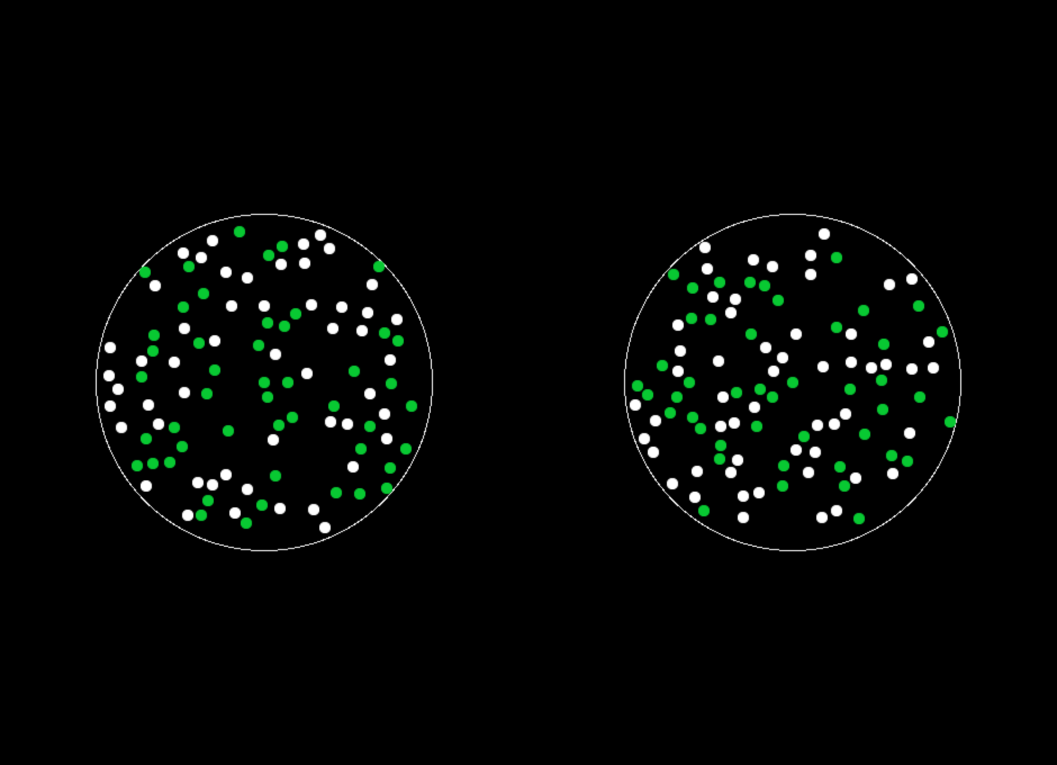
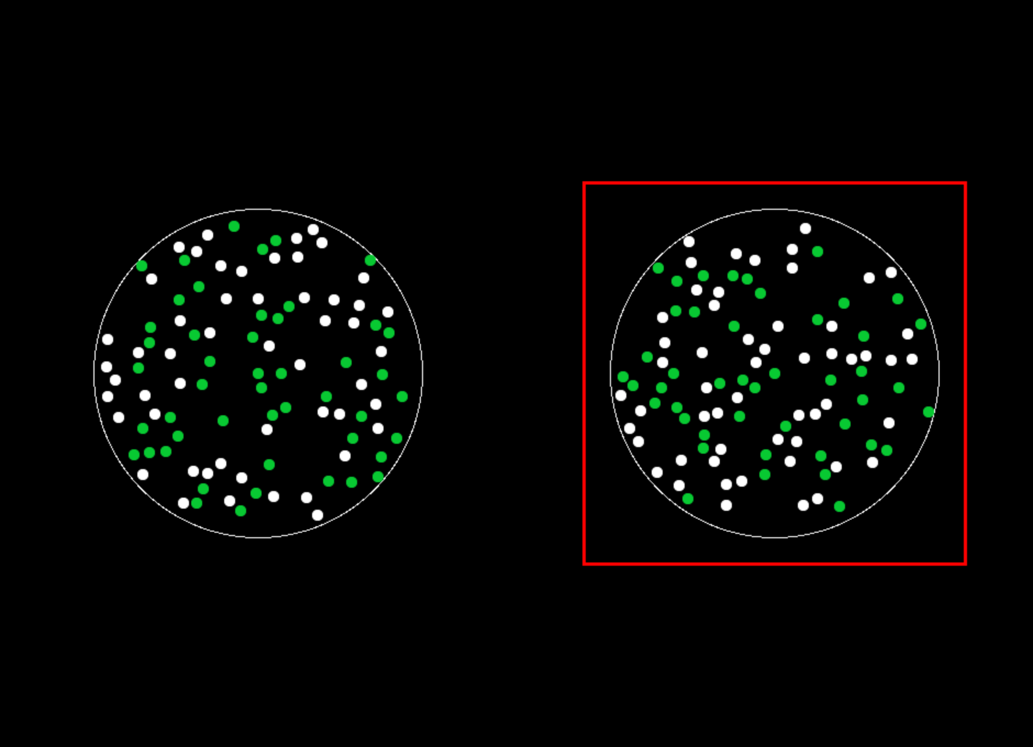

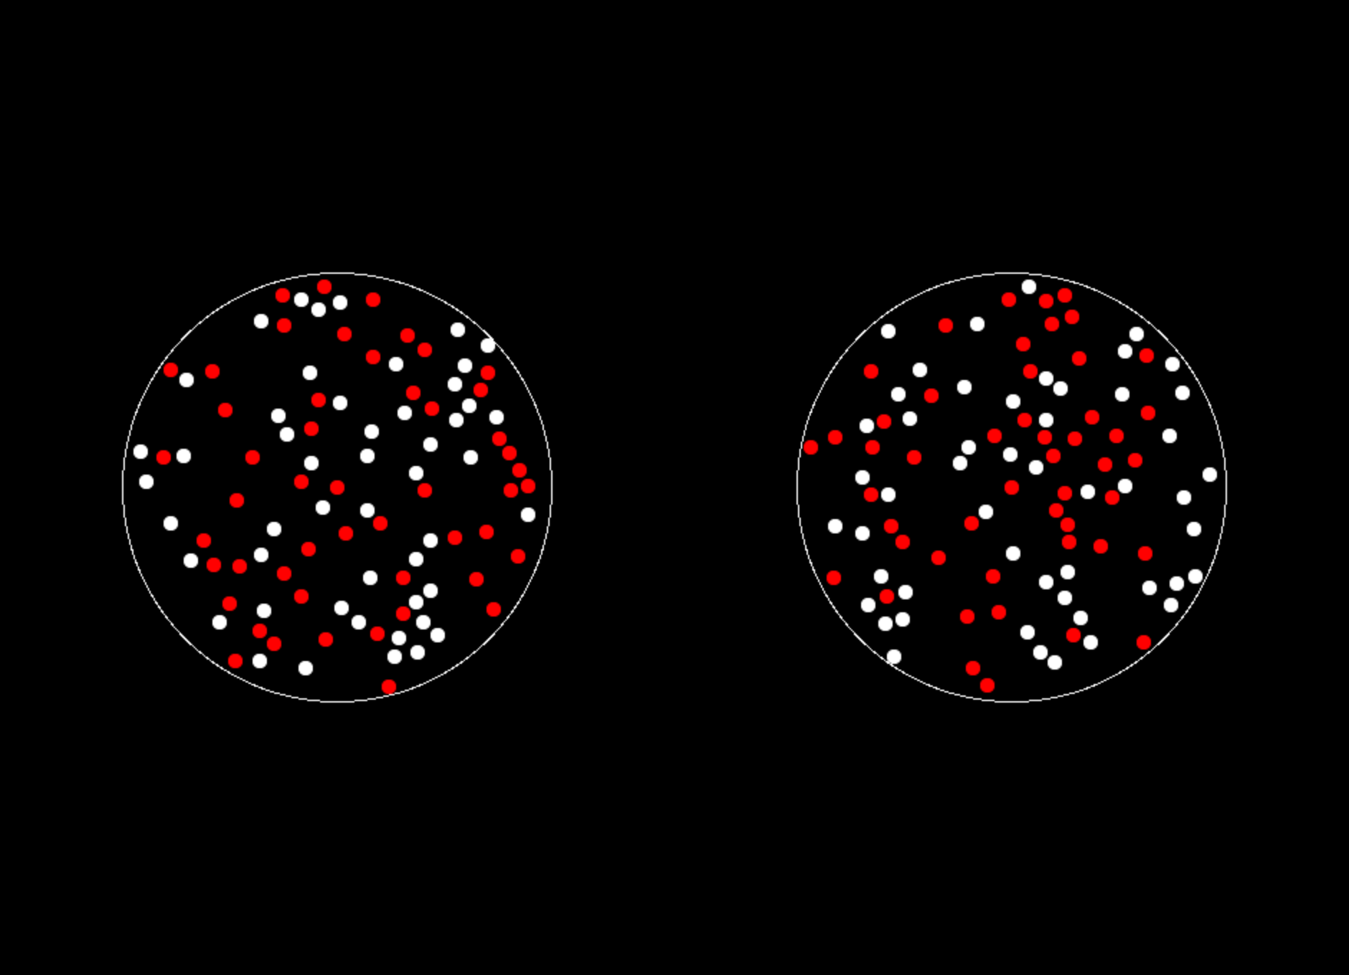
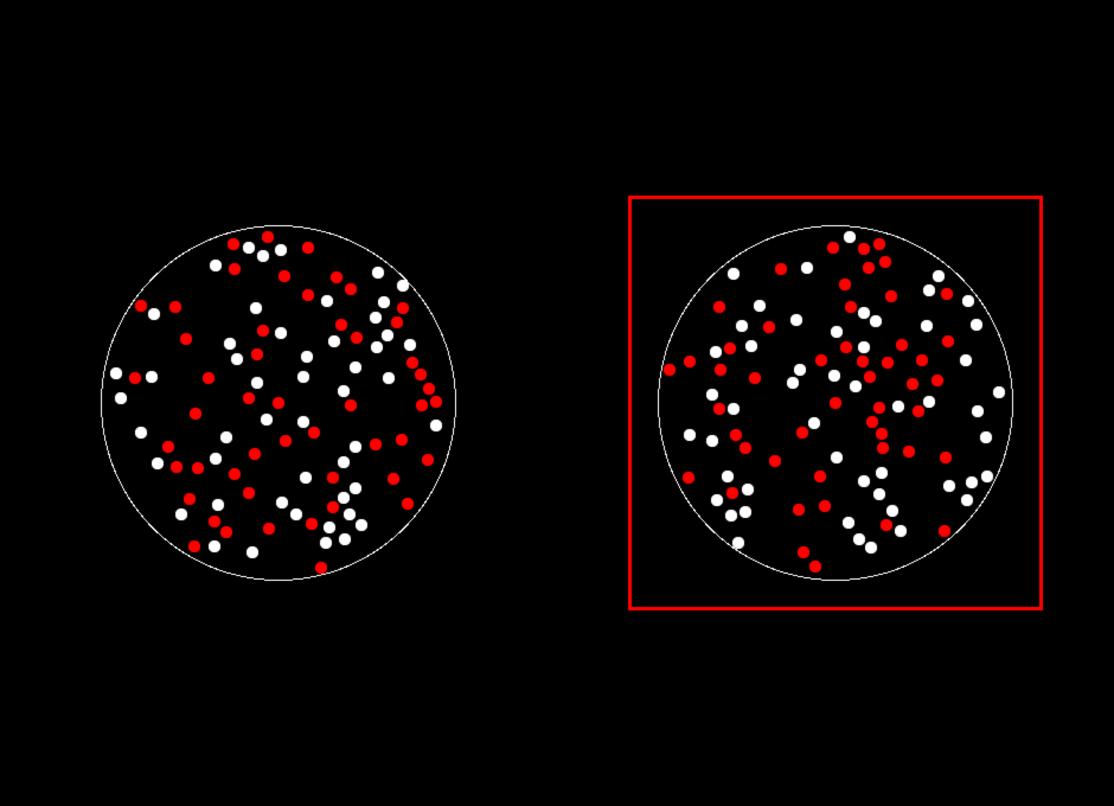
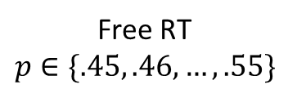
Gain
Loss
ITI
1 s
Free RT
$$p∈\{.45, .46, …, .55\}$$
Feedback
1 s
Eye-tracking

Slide 58
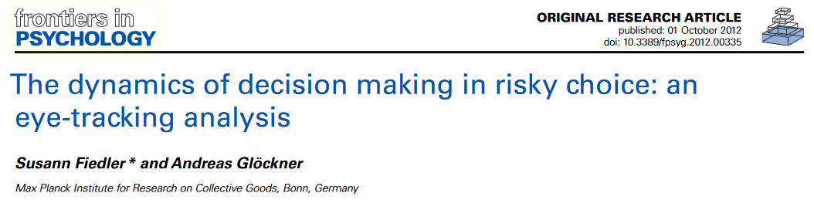
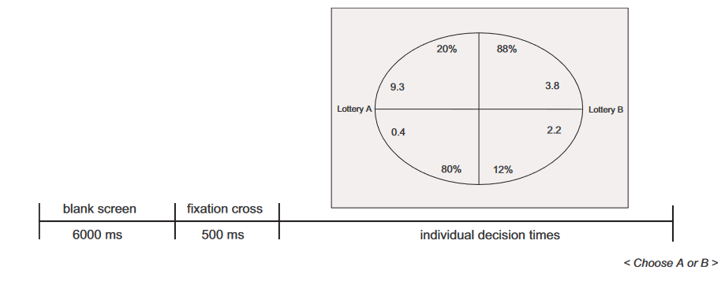

Slide 59
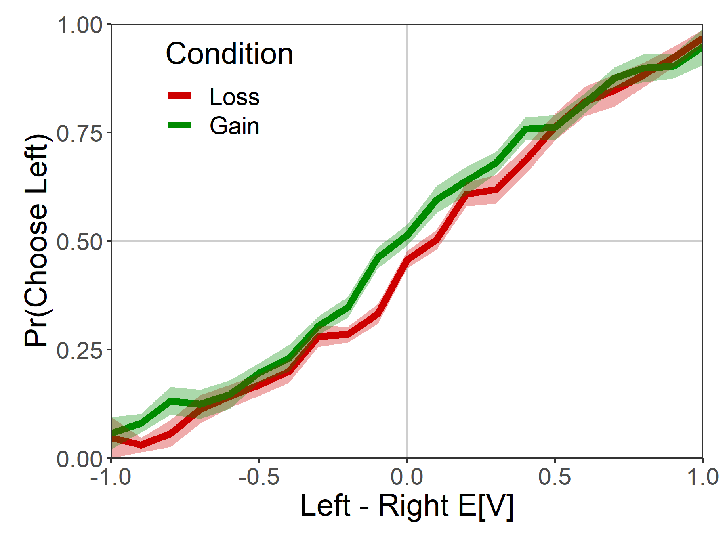
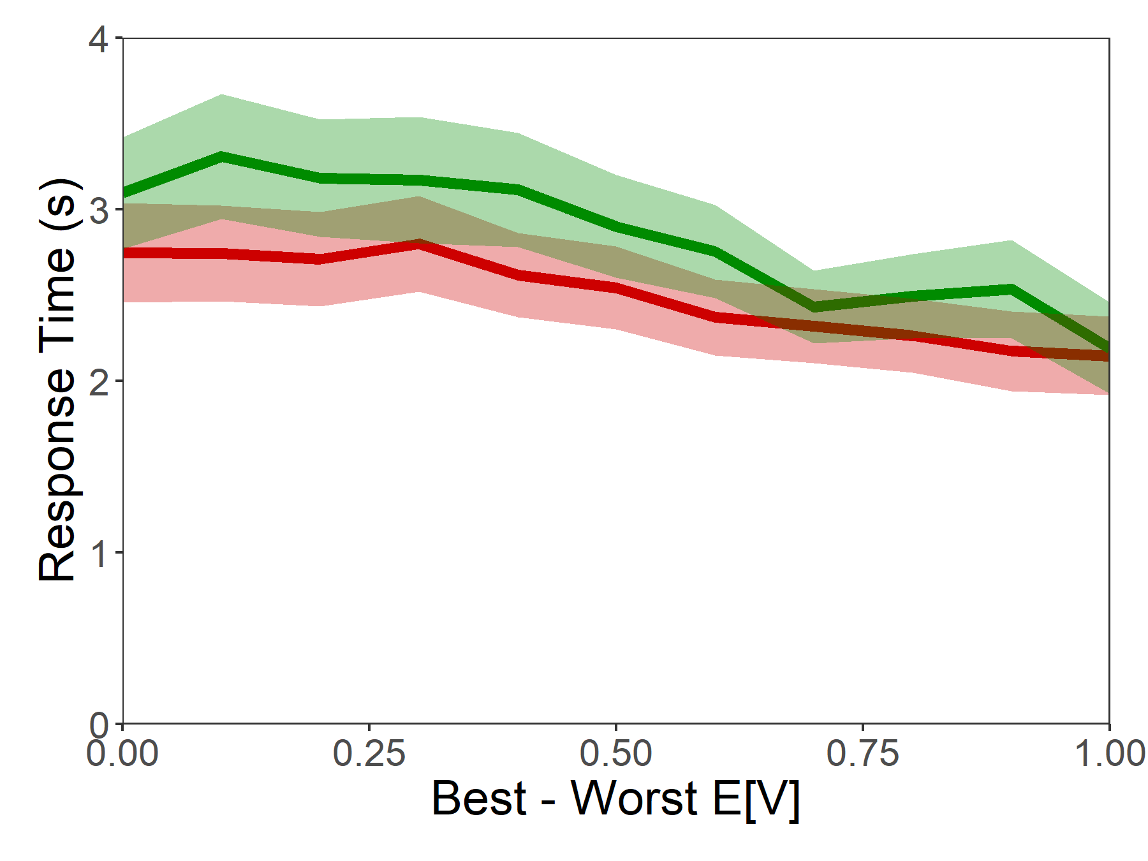
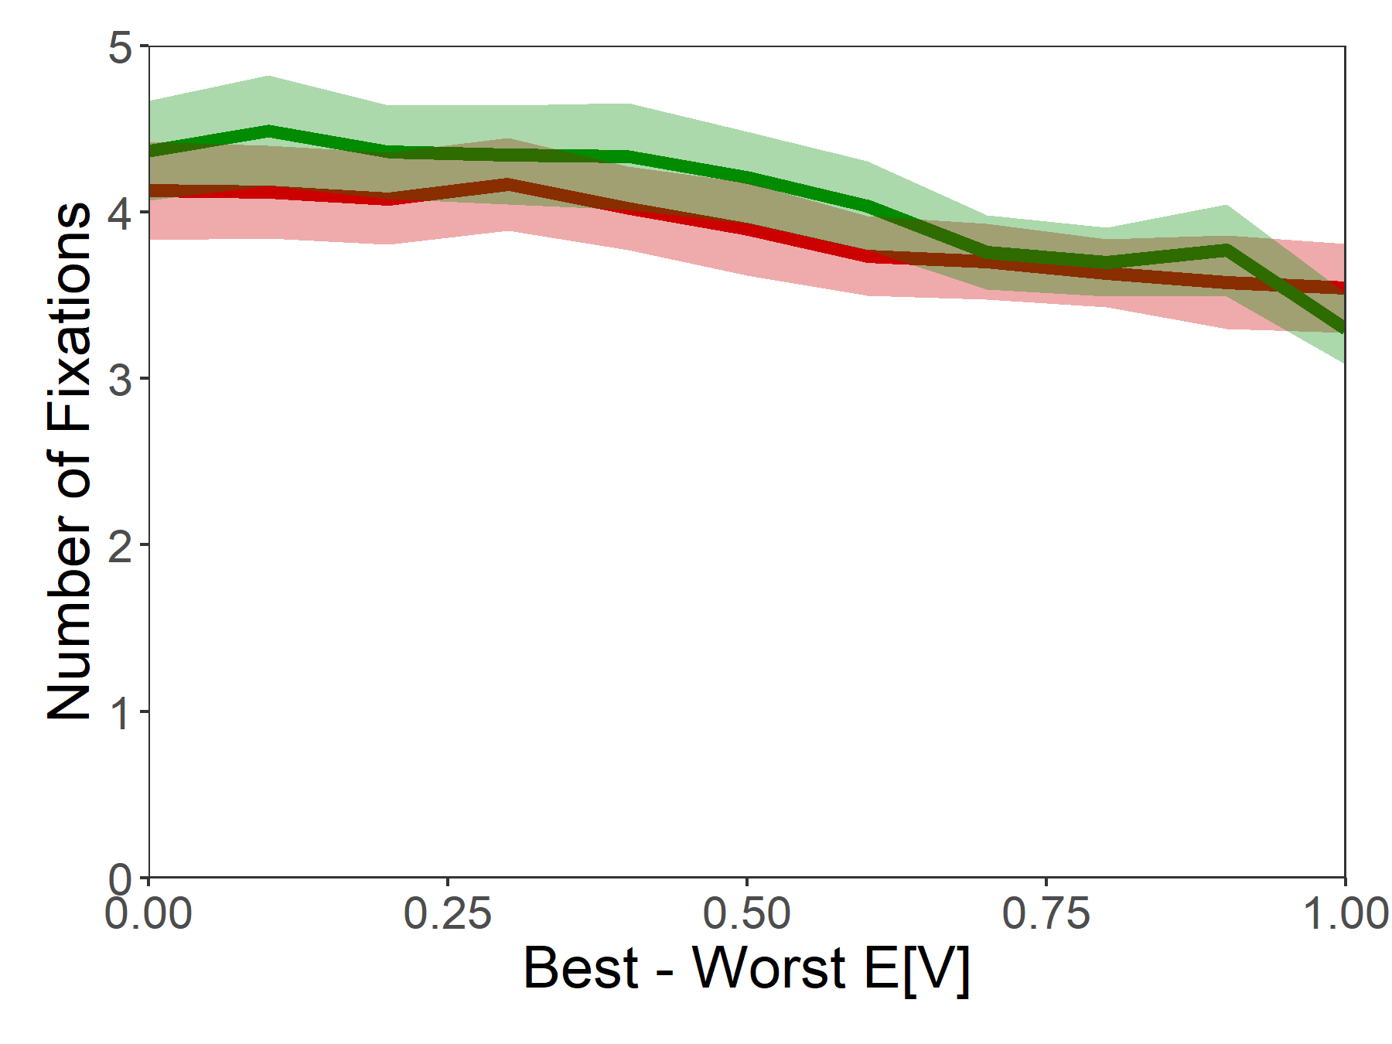
Psychometrics

Slide 60
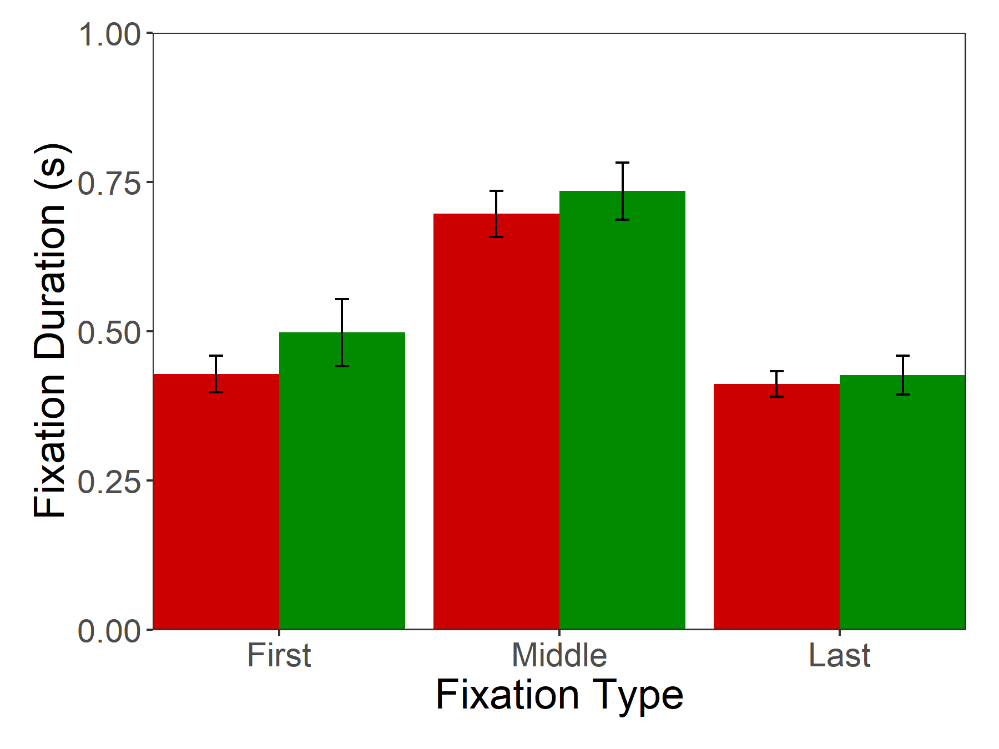
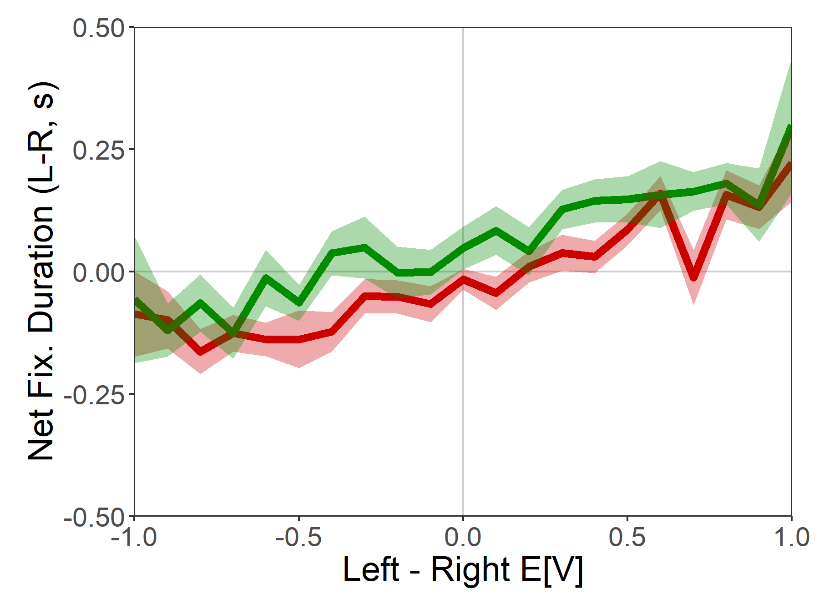
Fixation Properties

Slide 61
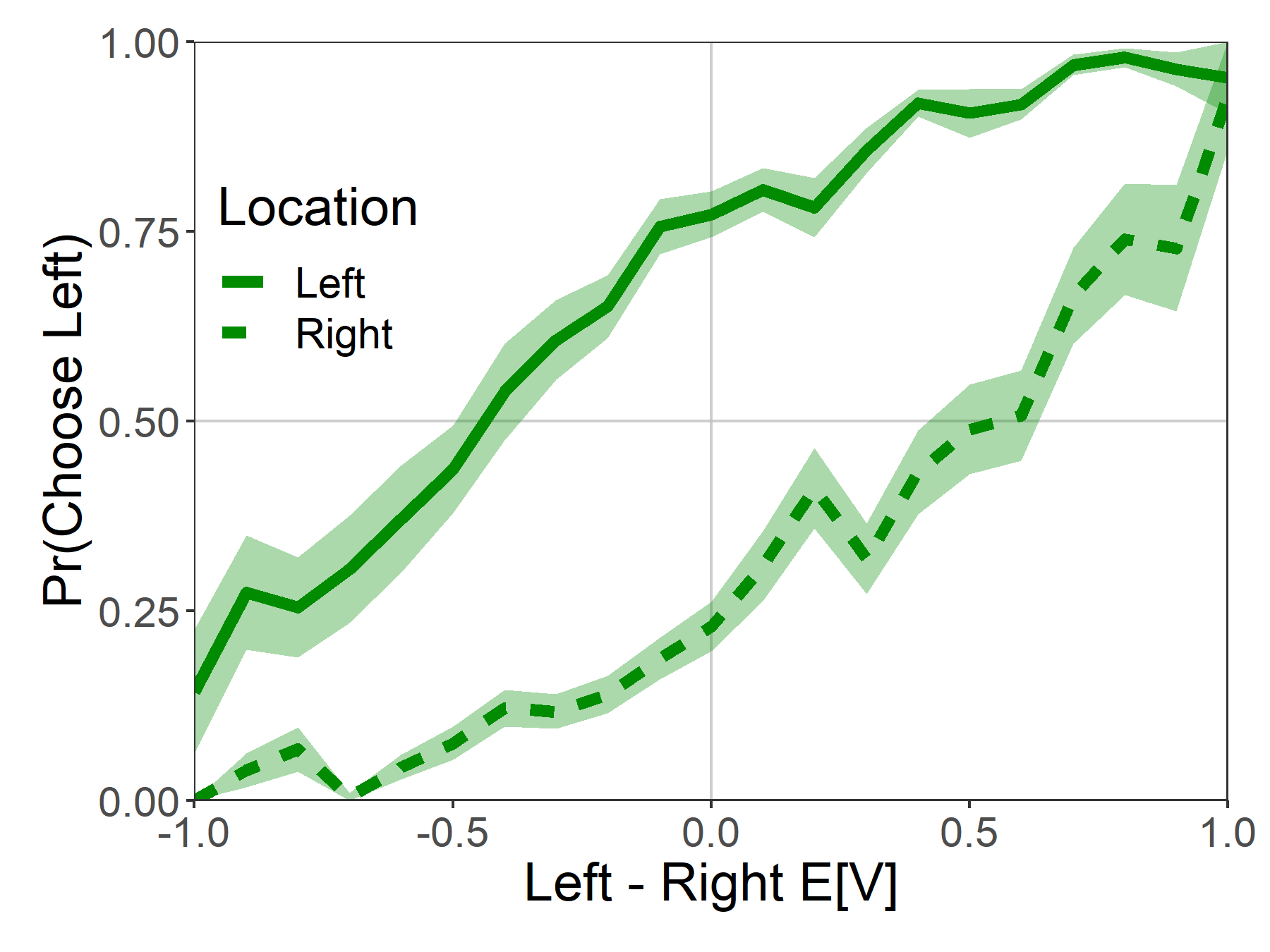

Attentional Choice Biases
Last Fixation Bias
Net Fixation Bias

Slide 62

Attentional Choice Biases
Last Fixation Bias
Net Fixation Bias

Slide 63

Attentional Choice Biases
Last Fixation Bias
Net Fixation Bias

Slide 64





aDDM Parameter Estimates
$evidence_{t}=evidence_{t−1}+μ_{t}+e_{t}$
Looking left: $μ_{t}=d(V_{L}−θV_{R})$
Looking right: $μ_{t}=d(θV_{L}−V_{R})$
$$e_{t}∼N\left(0, σ^{2}\right)$$
$evidence_{0}=b$

Slide 65
Possible Explanations
There is a fundamental difference in the role of attention in choices between losses than in choices between gains.
Subjects may be solving the task by counting the number of green dots in gains, but counting the number of white dots in losses.
Subjects are evaluating the value of the options with respect to a reference point, e.g. the minimum of the two options.

Slide 66
Next Steps
Shifting to choices between two lotteries with numerical representations.
$14.95
43.97%
$12.69
55.76%
-$8.12
78.43%
-$10.18
67.65%
E[V]=6.57
E[V]=7.08
E[V]=-6.37
E[V]=-6.88

